Slide 1

Writing Standout Resumes
How to impress recruiters and land your dream job
Aamogh Sawant

Slide 2

What We're Learning Today
Here are the topics we will cover this morning:
What is a resume?
Different resume formats.
What you need to know before making a resume.
Resume writing tips to help you get hired.

Slide 3
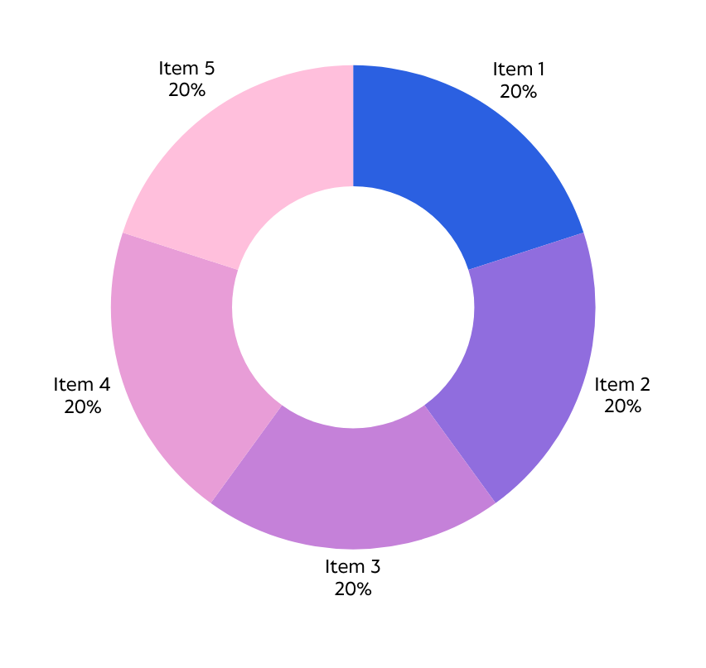
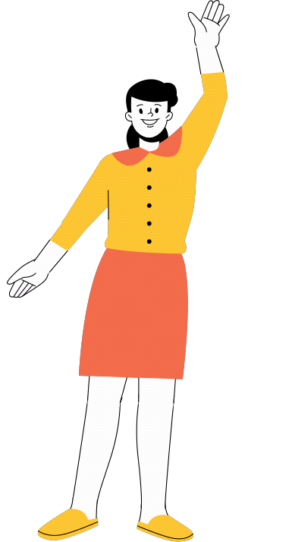
TOP RESUME MISTAKES
Spelling and grammar errors seem small but can be a major turn-off.
Visualize complicated and dense information with graphs and charts. These are visual aids that help add more context to the topic you are discussing.
TAKE A LOOK AT OTHER COMMON RESUME WRITING BASED ON A GLOBAL SURVEY.

Slide 4
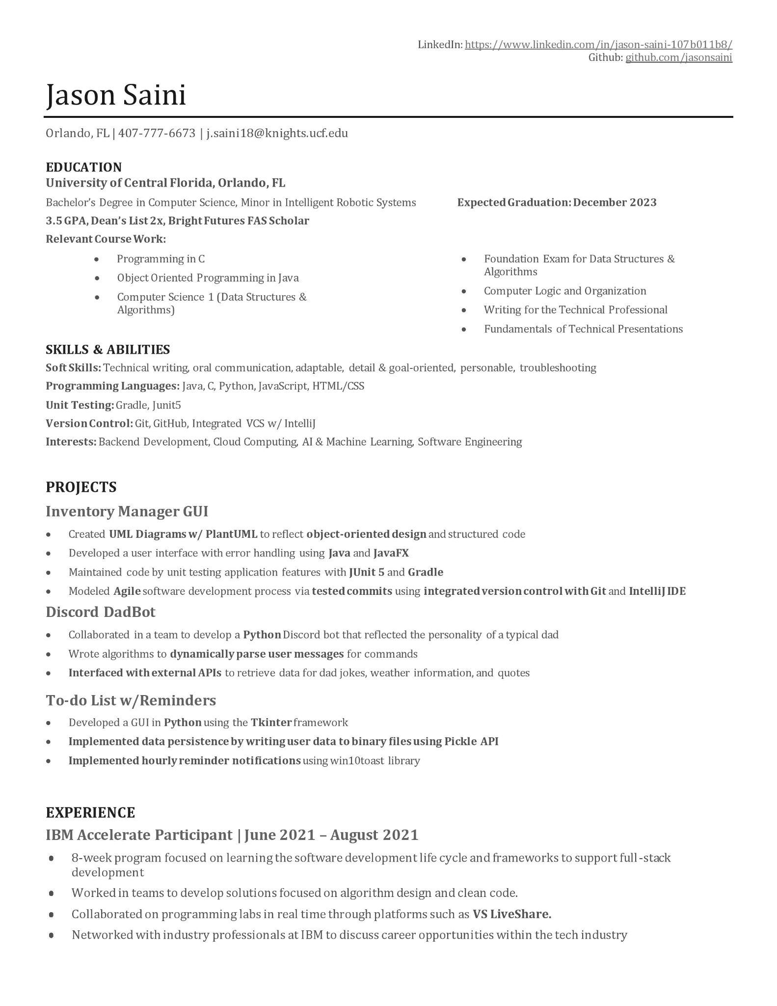
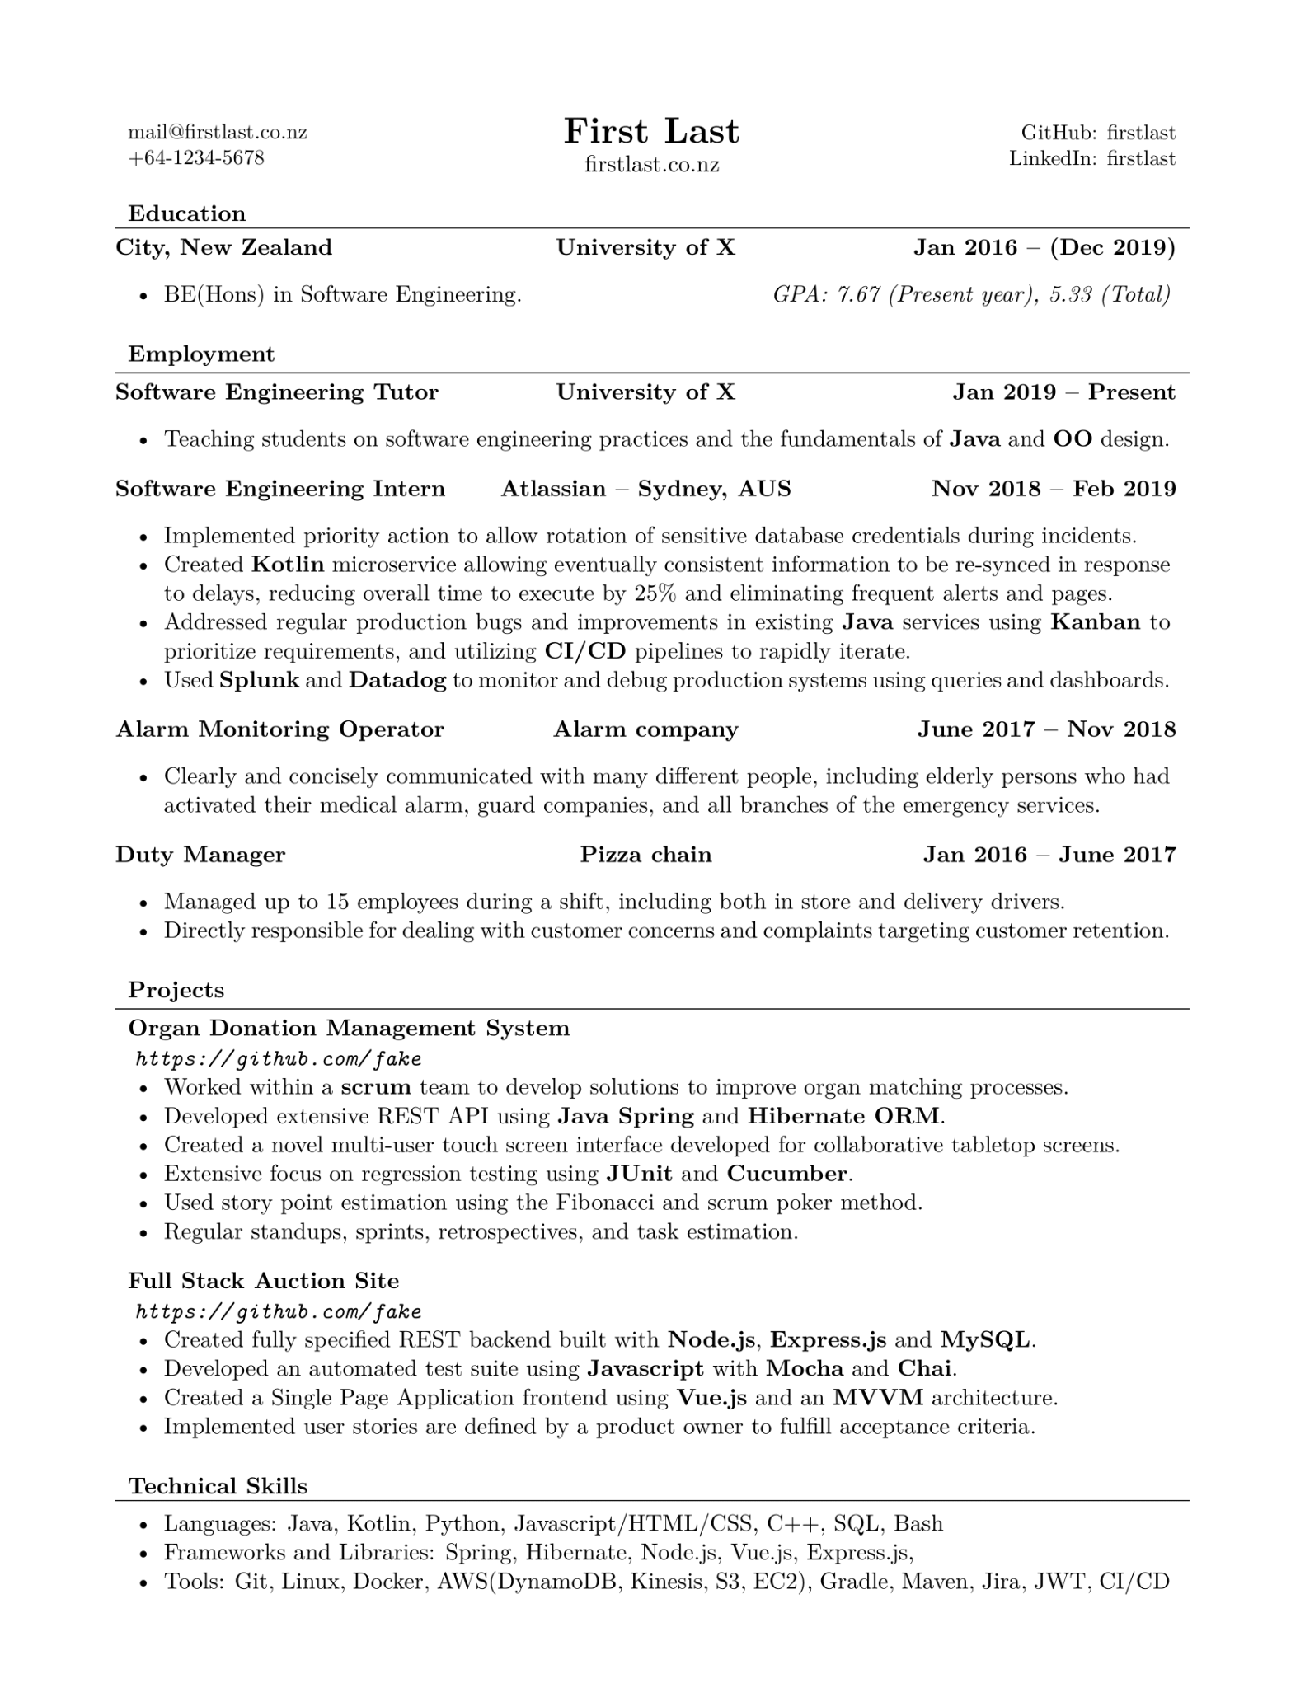
←Before
After→

Slide 5
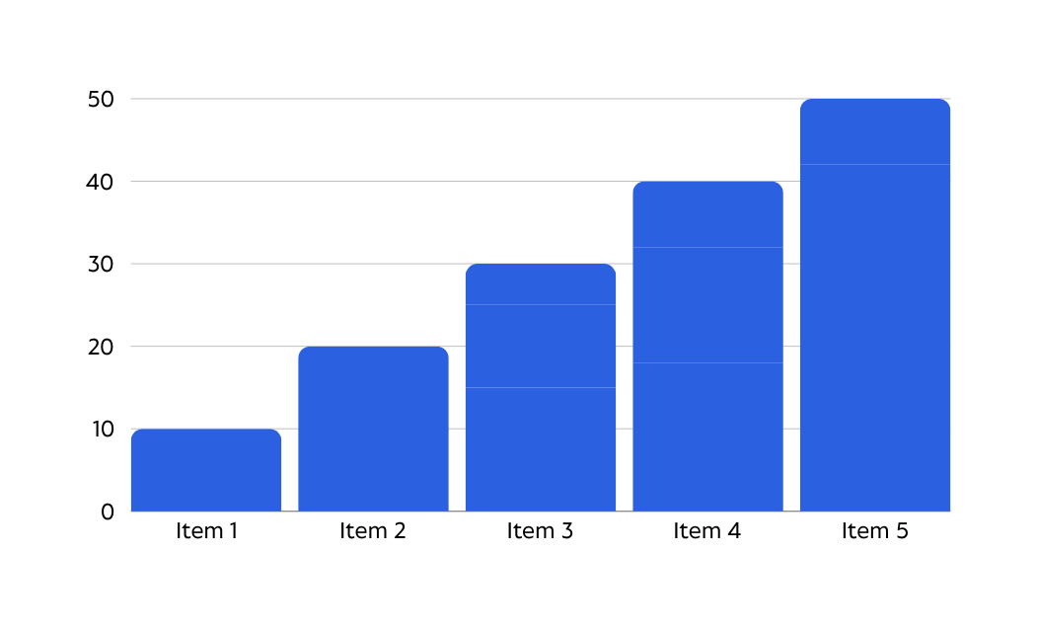
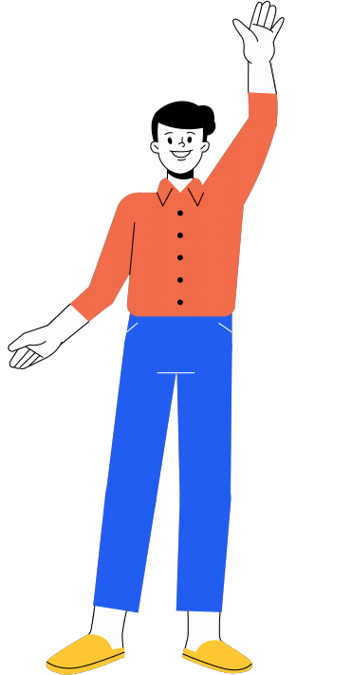
WHAT RECRUITERS WANT TO KNOW
Including these in your resume helps you
stand out and get called in.
Technical Skills: Do you have the specific skills needed for the job? They’ll look for evidence of expertise in areas relevant to the role, such as software, methodologies, or industry-specific skills.
Relevant Experience: Are your past roles and responsibilities aligned with the job? They want to see how your previous experiences prepare you for this new position.
Job History and Longevity: Recruiters look at your job history for patterns, like frequent job changes or gaps. They want to understand the reasons behind these changes to gauge your stability.
Professional Reputation: How do others view you professionally? They may contact references or check for recommendations, looking for validation of your reliability and integrity.

Slide 6
My Best Resume Writing Tips
1
Avoid vague terms like "detail-oriented" or "hard worker."
3
Make your contact information more prominent.
5
Use clean, job-appropriate templates.
2
Cite instances your skills benefited your team or employer.
4
Use bullet points for better readability.

Slide 7
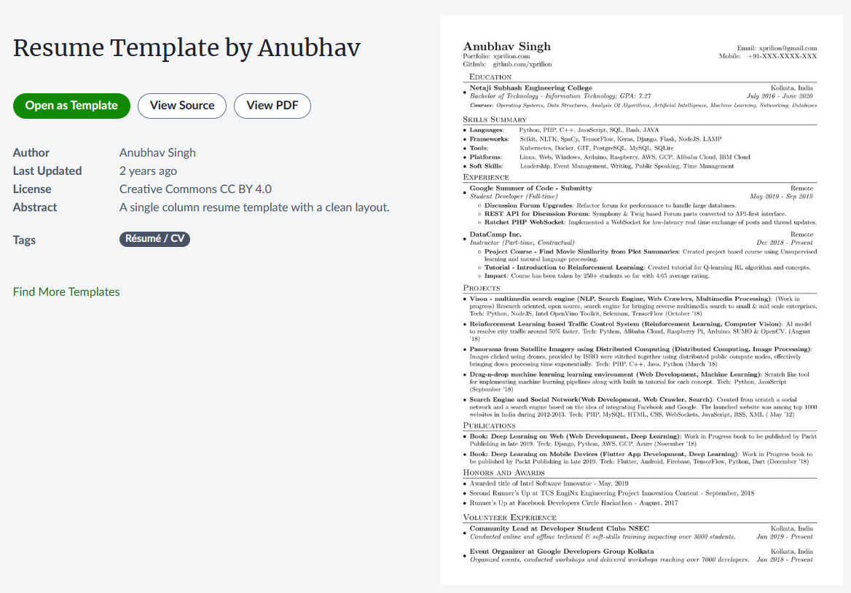
LaTex Resume Template by Anubhav - Overleaf, Online LaTeX Editor Used and recommended by many tech companies and their employees. Latex to PDF

Slide 8

Thank you for attending!
Feel free message me on discord!

